Slide 1

Intro to object-oriented programming
Chapter 10 - Inheritance

Slide 2
inheritance
The third tenet of OOP is inheritance, which is a mechanism for deriving a new class from an existing class. Rather than starting from scratch and potentially duplicating code, inheritance allows a programmer to write code for a new class that extends or differentiates it from an existing class.
Let’s begin with a real-world example that demonstrates what inheritance is basically about. You’re attending culinary school. One of your lessons involves an exhaustive demonstration of making hamburgers. You learn everything that there is to know about the different cuts of meat, the grinding of the meat, the best types of buns, the best lettuce, tomato, and condiments—just about everything you could imagine. You also learn about the best way to cook the hamburger, how long to cook it, when and how often to flip it over, and so on.
The next lesson in the curriculum is about cheeseburgers. The instructor could start from scratch and go through all the material about hamburgers again. But instead, they assume that you’ve retained the knowledge from the previous lesson and so already know everything there is to know about creating a great hamburger. This lesson therefore focuses on what types of cheese to use, when to add it, how much to use, and so on.
The point of the story is that there is no need to “reinvent the wheel”; instead, you can simply add on to what you already know.

Slide 3
Inheritance in Object-Oriented Programming
Inheritance in OOP is the ability to create a class that builds on (extends) an existing class. When creating large programs, you will often use classes that provide very useful general capabilities. You’ll sometimes want to build a class that’s similar to a class that already exists, but does some things slightly differently. Inheritance allows you to do just that, creating a new class that includes all the methods and instance variables of an existing class, but adds new and different functionality.
Inheritance is an extremely powerful concept. When classes are set up correctly, using inheritance can seem simple. However, being able to design classes to use it in a clear manner is a skill that’s difficult to master. As an implementer, inheritance takes a great deal of practice to use properly and efficiently.
With inheritance, we talk about the relationship between two classes, typically referred to as the base class and subclass.
While these are the most common terms used to describe the two classes in Python, you may also hear them referred to in other ways, such as:
Superclass and subclass
Base class and derived class
Parent class and child class

Slide 4
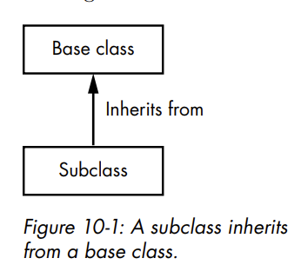
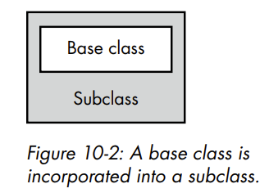
INHERITANCE IN OBJECT-ORIENTED PROGRAMMING
A subclass inherits all of the methods and instance variables defined in a base class

Slide 5
INHERITANCE IN OBJECT-ORIENTED PROGRAMMING
As the implementer, you can think of the base class as being incorporated into the subclass. That is, the base class actually becomes part of the larger subclass. As a client of a subclass, you think about the subclass as a single unit and do not need to know that the base class is there at all.
When discussing inheritance, we often say there is an is a relationship between a subclass and a base class. For example, a student is a person, an orange is a fruit, a car is a vehicle, and so on. The subclass is a specialized version of the base class that inherits all the properties and behavior of the base class, but also provides additional details and functionality.
Most importantly, a subclass extends a base class in either or both of the following ways (which will be explained soon):
A subclass can redefine a method that’s defined in the base class. That is, a subclass can provide a method with same name as one in the base class but with different functionality. This is called overriding a method. When client code makes a call to an overridden method, the method in the subclass is called. (However, the code of the method in the subclass can still call the method of the same name in the base class.)
A subclass can add new methods and instance variables that do not appear in the base class.

Slide 6
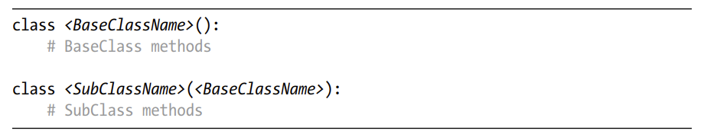
Implementing Inheritance
The syntax of inheritance in Python is simple and elegant. The base class does not need to know that it is being used as a base class. Only the subclass needs to indicate that it wants to inherit from a base class. Here is the general syntax:
In the class statement of the subclass, within the parentheses you specify the name of the base class it should inherit from

Slide 7
Employee and Manager Example
The Employee class has the methods __init__(), getName(), getTitle(), and payPerYear(). It also has three instance variables, self.name, self.title, and self.ratePerHour, which are set in the __init__() method. We retrieve the name and title using getter methods. These employees are paid per hour, so self.payPerYear() does a calculation to determine the annual pay based on the hourly rate. Everything in this class should be familiar to you; there is nothing new here. You can instantiate an Employee object by itself, and it will work fine.
For the Manager class, we consider the differences between a manager and an employee: the manager is a salaried employee who has a number of direct reports. If this manager does a good job, they get a 10 percent bonus for the year. The Manager class can extend the Employee class, since the manager is an employee but has additional capabilities and responsibilities
Example: Employee class and Manager subclass

Slide 8
EMPLOYEE AND MANAGER EXAMPLE
The Manager class has an added getter method, getReports(), that allows client code to retrieve a list of Employees who report to the Manager. The payPerYear() method calculates and returns the Manager’s pay.
Notice that both the Employee and the Manager classes have a method named payPerYear(). If you call the payPerYear() method using an instance of Employee, the Employee class’s method will run and calculate the pay based on the hourly rate. If you call the payPerYear() method with an instance of Manager, the Manager class’s method will run and do a different calculation. The payPerYear() method in the Manager class overrides the method by the same name in the base class. Overriding a method in a subclass specializes the subclass to differentiate it from the base class.
The overriding method must have the exact same name as the method that it overrides (although it may have a different list of parameters). In the overriding method, you can:
Completely replace the overridden method in the base class. We see this in the payPerYear() method of the Manager class.
Do some work on its own and call the inherited or overridden method of the same name in the base class. We see this in the __init__() method of the Manager class.
Example: Test code

Slide 9
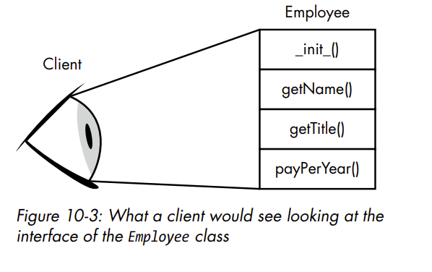
The Client’s View of a Subclass
The discussion so far has been focused on the details of implementation. But classes can look different depending on whether you are the developer of a class or are writing code to use a class. Let’s change focus and take a look at inheritance from the client’s point of view.
As far as client code is concerned, a subclass has all the functionality of the base class, plus anything defined in the subclass itself. It may help to think about the resulting collection of methods as layers of paint on a wall. When a client looks at the Employee class, the client sees all the methods defined in that class

Slide 10
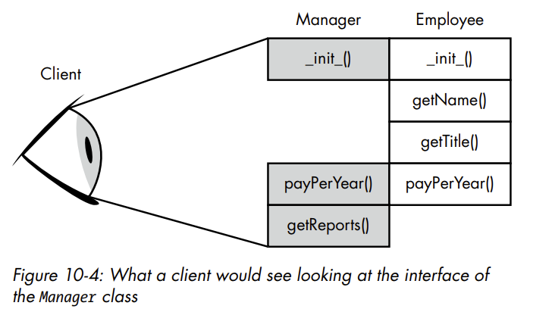
THE CLIENT’S VIEW OF A SUBCLASS
When we introduce the Manager class that inherits from the Employee class, it’s like adding paint to touch up the places where we want to add or change methods. For methods that we don’t want to change, we just leave the old layer of paint
As the developer, we know that the Manager class inherits from the Employee class and overrides some methods. As the client, we just see five methods. The client doesn’t need to know that some methods are implemented in the Manager class and others come from the inherited Employee class

Slide 11
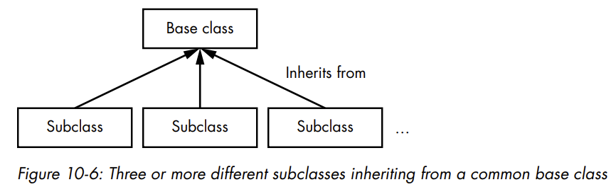
Multiple Classes Inheriting from the Same Base Class
Multiple different classes can inherit from the same base class. You can build a very general base class, then construct any number of subclasses that inherit from it
Each of the different subclasses can then be a variant (a more specific version) of the generic base class. Each subclass can override any methods of the base class that it wants to or needs to, independent of any other subclass

Slide 12

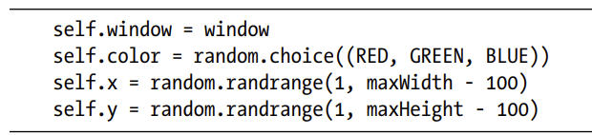
MULTIPLE CLASSES INHERITING FROM THE SAME BASE CLASS
Let’s walk through an example using the Shapes program that created and drew circles, squares, and triangles. The code also allowed the user to click on any shape in the window to see the area of that shape. The program was implemented with three different shape classes: Circle, Square, and Triangle. If we look back at those three classes, we find that each one has this exact same method:
Further, looking at the __init__() methods of the three classes, we find that there is some common code that remembers the window, chooses a random color, and chooses a random location:
Finally, each class sets the instance variable self.shapeType to an appropriate string. Whenever we find a set of classes that implement the exact same method and/or share some code in a commonly named method, we should recognize that this is a good candidate for inheritance. Let’s extract the common code from the three classes and build a common base class named Shape
EXAMPLE: Shape class

Slide 13
Abstract Classes and Methods
Unfortunately, our Shape base class has a potential bug. At the moment, a client could instantiate a generic Shape object, which is too generic to have its own getArea() method. Further, all classes that inherit from the Shape class (like Square, Circle, and Triangle) must implement clickedInside(), getArea(), and draw(). To solve both of these problems, I’ll introduce the concepts of an abstract class and an abstract method.
Abstract class - A class that is not intended to be instantiated directly, but only to be used as a base class by one or more subclasses. (In some other languages, an abstract class is referred to as a virtual class.
Abstract method - A method that must be overridden in every subclass.
Often, a base class cannot correctly implement an abstract method because it cannot know the detailed data it should operate on, or it may not be possible to implement a general algorithm. Instead, all subclasses need to implement their own version of the abstract method.

Slide 14



ABSTRACT CLASSES AND METHODS
In our shapes example, we want the Shape class to be an abstract class so no client code can instantiate a Shape object. Further, our Shape class should indicate that all its subclasses need to implement the clickedInside(), getArea(), and draw() methods.
Python does not have a keyword to designate a class or method as abstract. However, the Python Standard Library contains the abc module, short for abstract base class, which is designed to help developers build abstract base classes and methods.
Let’s take a look at what we need to do to build an abstract class with abstract methods. To begin, we need to import two things from the abc module:
Next, we need to indicate that the class we want to act as an abstract base class should inherit from the ABC class, which we do by putting ABC inside parentheses after the class name:
We then must use the special decorator @abstractmethod before any methods that must be overwritten by all subclasses:

Slide 15
ABSTRACT CLASSES AND METHODS
Example: The Shape base class that inherits from ABC with abstract methods
The Shape class inherits from the ABC class 1, telling Python to prevent client code from instantiating a Shape object directly. Any attempt to do so results in the following error message:
The __init__() and getType() methods contain code that will be shared by all subclasses of Shape.
The clickedInside(), getArea(), and draw() methods are all preceded by the @abstractmethod decorator. This decorator indicates that these methods must be overwritten by all subclasses of Shape. Since these methods in this abstract class will never run, the implementation here consists only of raise NotImplementedError to further emphasize that the method doesn’t do anything.

Slide 16

ABSTRACT CLASSES AND METHODS
Let’s extend the shape demonstration program to add a new Rectangle class. The Rectangle class inherits from the abstract Shape class and therefore must implement the clickedInside(), getArea(), and draw() methods. I’ll make an intentional error in this subclass to show what happens.
Example: The Rectangle class that implements clickedInside() and getArea(), but not draw()
As a demonstration, this class mistakenly does not contain a draw() method. Example shows a modified version of the main code that includes the creation of Rectangle objects.
Example: The main code that randomly creates Squares, Circles, Triangles, and Rectangles
When this code attempts to create a Rectangle object, Python generates this error message:
This tells us that we cannot instantiate a Rectangle object because we did not write a draw() method in our Rectangle class. Adding a draw() method to the Rectangle class (with appropriate code to draw the rectangle) fixes the error.

Slide 17
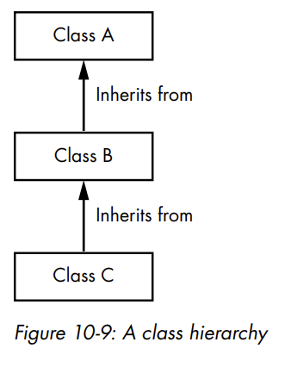
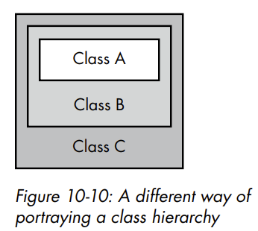
Class Hierarchy
Any class can be used as a base class, even a subclass that already inherits from another base class. This kind of relationship, known as a class hierarchy, is depicted in Figure 10-9.
In this figure, class C inherits from class B, which inherits from class A. Therefore, class C is a subclass and class B is a base class, but class B is also a subclass of class A. So, class B serves in both roles. In cases like this, class C inherits not only all the methods and instance variables in class B, but also all the methods and instance variables in class A. This type of hierarchy can be very useful when building more and more specific classes. Class A can be very general, class B more detailed, and class C even more specific
Figure 10-10 provides a different way to think about the relationships in a class hierarchy. Here, the client sees only class C, but this class is made up of all the methods and instance variables defined collectively in classes C, B, and A.

Slide 18
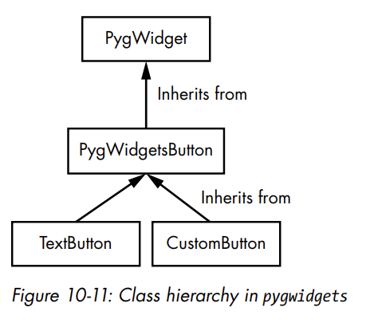
CLASS HIERARCHY
The pygwidgets package uses a class hierarchy for all widgets. The first class in pygwidgets is the abstract class PygWidget, which supplies basic functionality to all widgets in the package. Its code consists of methods that allow for showing and hiding, enabling and disabling, getting and setting the location, and getting the nickname (internal name) of any widget. There are other classes in pygwidgets that are used as abstract classes, including the aforementioned PygWidgetsButton, which is the base class of both TextButton and CustomButton. Figure 10-11 should help make this relationship clear.
As you can see, the PygWidgetsButton class is both a subclass of PygWidget and a base class for TextButton and CustomButton.

Slide 19
The Difficulty of Programming with Inheritance
When developing using inheritance, it can be difficult to understand what to put where. You’re constantly asking yourself questions like: Should this instance variable be in the base class? Is there enough common code in subclasses to create a method in the base class? What are appropriate parameters for a method in a subclass? What are appropriate parameters and defaults to be used in a base class that expects to be overridden or called from a subclass?
Attempting to understand the interactions among all the variables and methods in a hierarchy of classes can be an extremely difficult, tricky, and frustrating task. This is especially true when reading the code of a class hierarchy developed by another programmer. To fully understand what’s going on, you often have to become familiar with the code in the base classes all the way up the hierarchy.
For example, imagine a hierarchy in which class D is a subclass of C, which is a subclass of B, which is a subclass of the base class A. In class D, you may encounter code that branches based on the value of an instance variable, but that variable might never be set in the code of class D. In cases like this, you must look for the instance variable in the code of class C. If it is not found there, then you must look in the code of class B, and so on.

Slide 20
THE DIFFICULTY OF PROGRAMMING WITH INHERITANCE
When designing a class hierarchy, perhaps the best way to avoid this problem is to only call methods and use instance variables inherited from one layer up in the hierarchy. In our example, code in class D should only make calls to methods in class C, while class C should only make calls to methods in class B, and so on. This is a simplistic version of the Law of Demeter. Stated simply, you (meaning objects) should only talk to your immediate friends (nearby objects) and never talk to strangers (distant objects). A detailed discussion is beyond the scope of this book, but there are many references available on the internet.
Another approach, which we first talked about in Chapter 4, is to take advantage of composition, where an object instantiates one or more other objects. The key difference is that inheritance is used to model an “is a” relationship, whereas composition uses a “has a” relationship. For example, if we wanted to have a spinbox widget (an editable text number field with an up and a down arrow), we could build a SpinBox class that instantiates a DisplayNumber object and two CustomButton objects for the arrows. Each of these objects already knows how to handle its user interactions.

Slide 21
Summary
The basic idea of inheritance is to build a class (a subclass) that incorporates all the methods and instance variables of another class (a base class), thereby allowing you to reuse existing code. Your new subclass can choose to use or override the methods of the base class, as well as define its own methods. A method in a subclass can find the base class by using a call to super().
Any client code that uses your subclass will see an interface that incorporates methods defined in both the subclass and the base class. Any number of subclasses can be built using the same base class. An abstract class is one that is not intended to be instantiated by client code, but rather is intended only to be inherited from by subclasses. An abstract method in a base class is one that must be overridden in each subclass.
I showed how you can build a class hierarchy, where a class inherits from another class, which in turn inherits from a third class, and so on. Inheritance can be complex—reading someone else’s code can be confusing—but as we’ve seen, inheritance can be extremely powerful.

